Slide 1
Holt of California
Emission Solutions
Rob Manzer

Slide 2
623E Tier III Repower

Slide 3
627F Tier III Repower

Slide 4
637D twin engine Tier III Repower

Slide 5
980C Tier III Repower

Slide 6
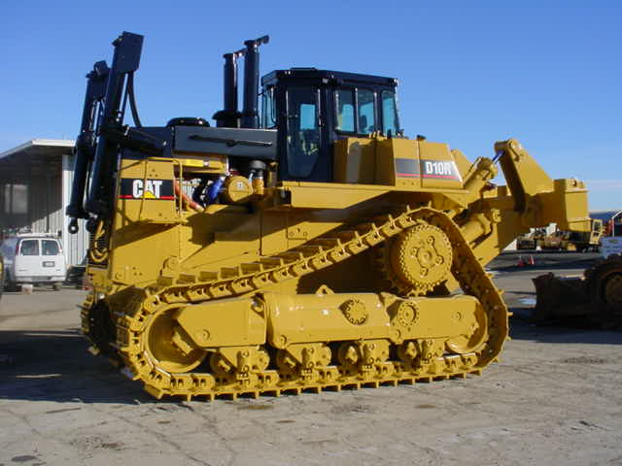
D10R Tier III Repower

Slide 7
D5 Tier III Repower

Slide 8
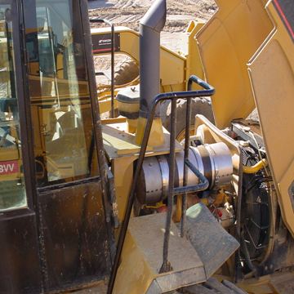
CAT DPF Solutions 175-300HP Tier 1 & 2

Slide 9
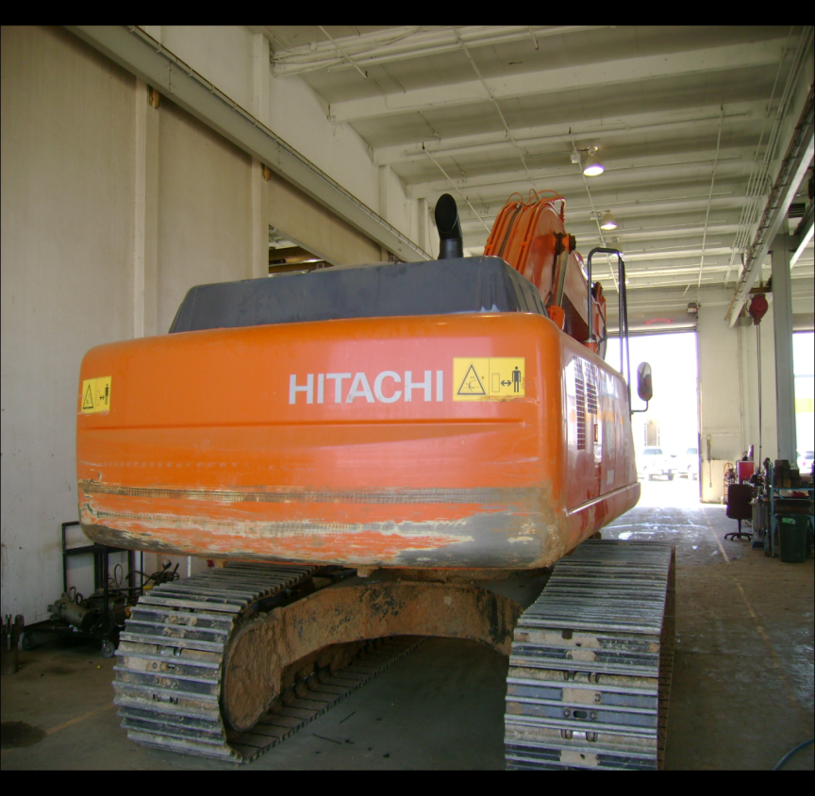
HITACHI EX330 with Cat DPF

Slide 10
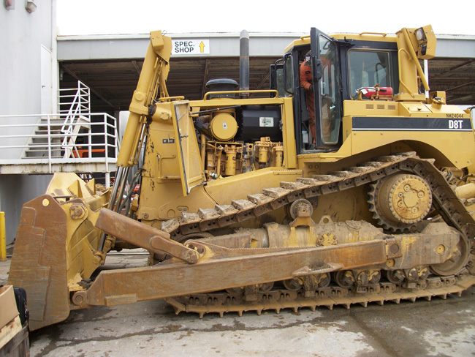
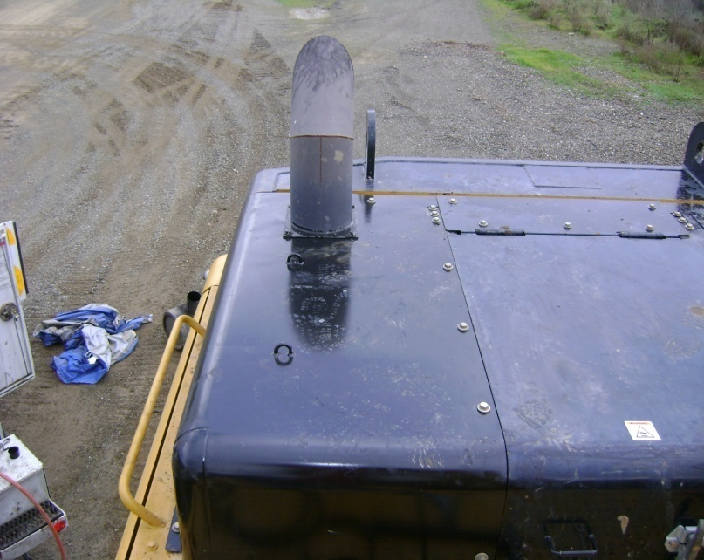
Non-Cat DPF Solutions

Slide 11
Questions?????

